Slide 1
Attendance Management System
Java Swing + MySQL
By
G. Jayanth - 24211A6731
K . Bharath – 24211A6746
K. Suraj Naga Krishna - 24211A6756

Slide 2
Introduction
The Attendance Management System digitalises attendance marking.
Features:
- Staff Login/Registration
- Class Selection
- Attendance Marking
- Search Attendance
- Student Attendance Records

Slide 3
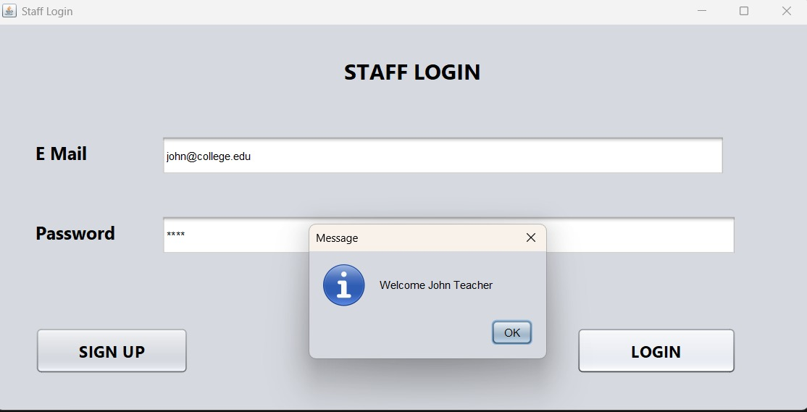
Login Page
Staff can log in using email and password.

Slide 4
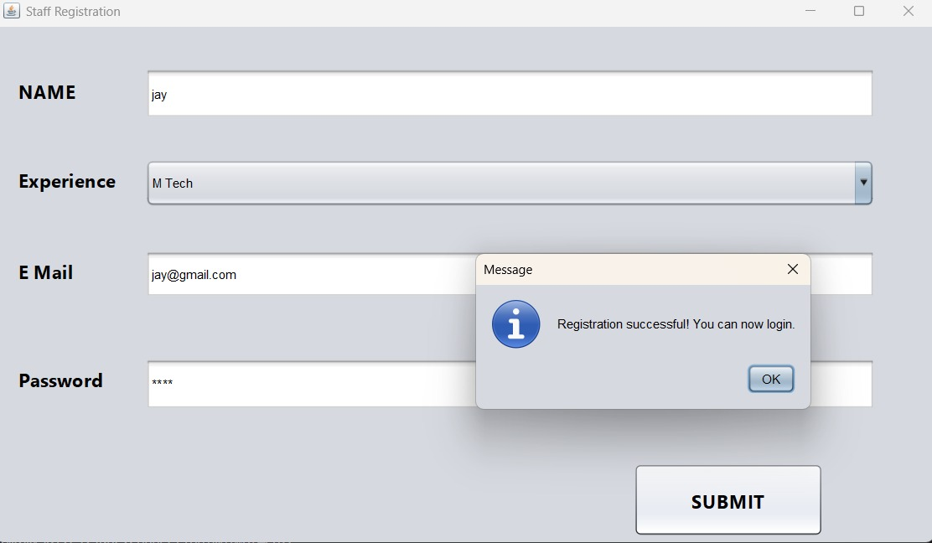
Registration Page
New staff can register and then log in.

Slide 5
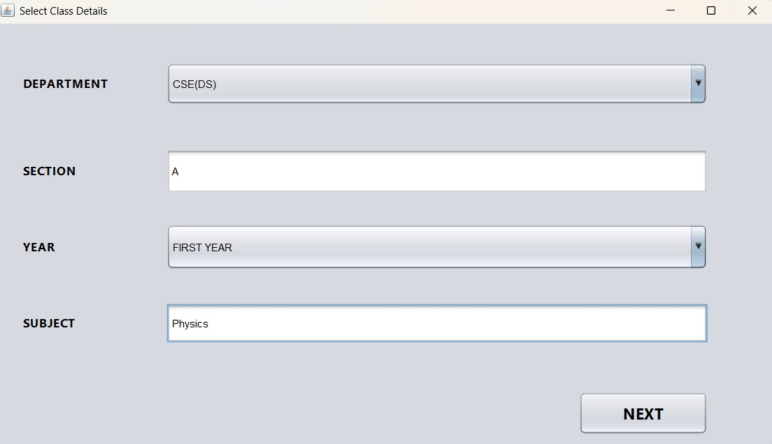
Class Selection Page
Staff selects Department, Section, Year, and Subject.

Slide 6
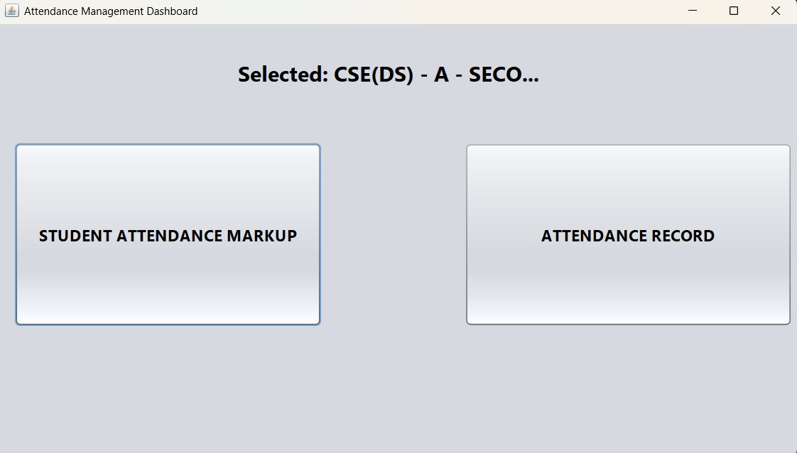
Dashboard
Dashboard provides:
- Student Attendance Markup
- Attendance Record

Slide 7
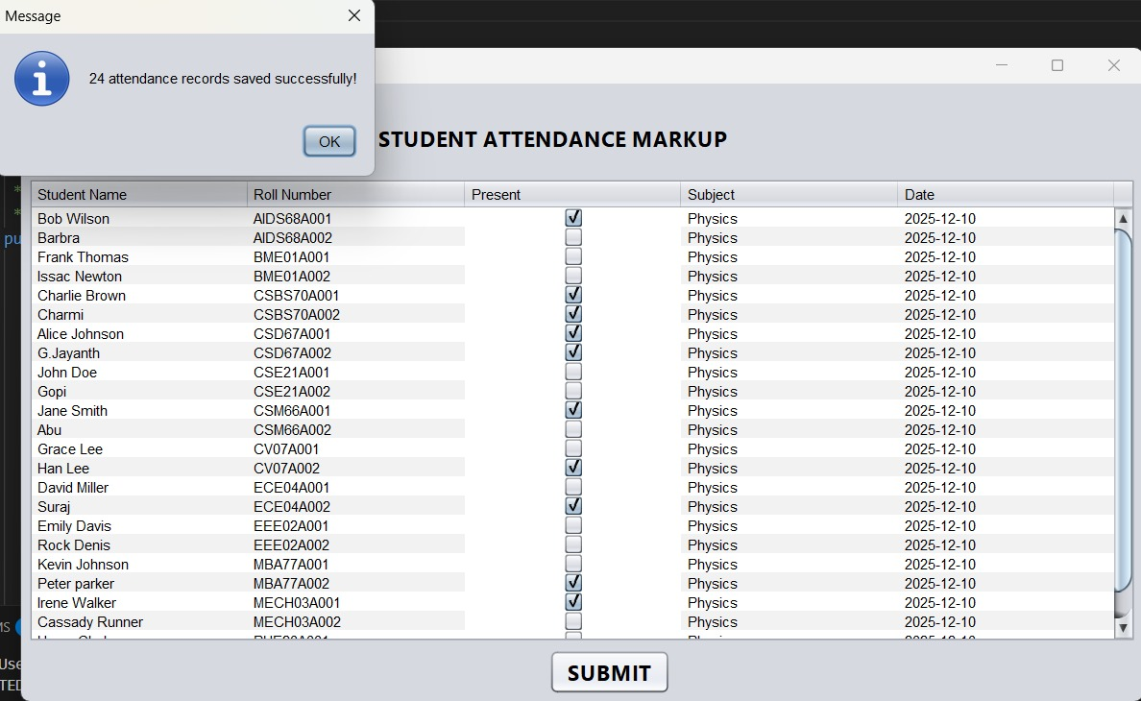
Attendance Marking
Staff marks Present/Absent. Records stored in MySQL.

Slide 8
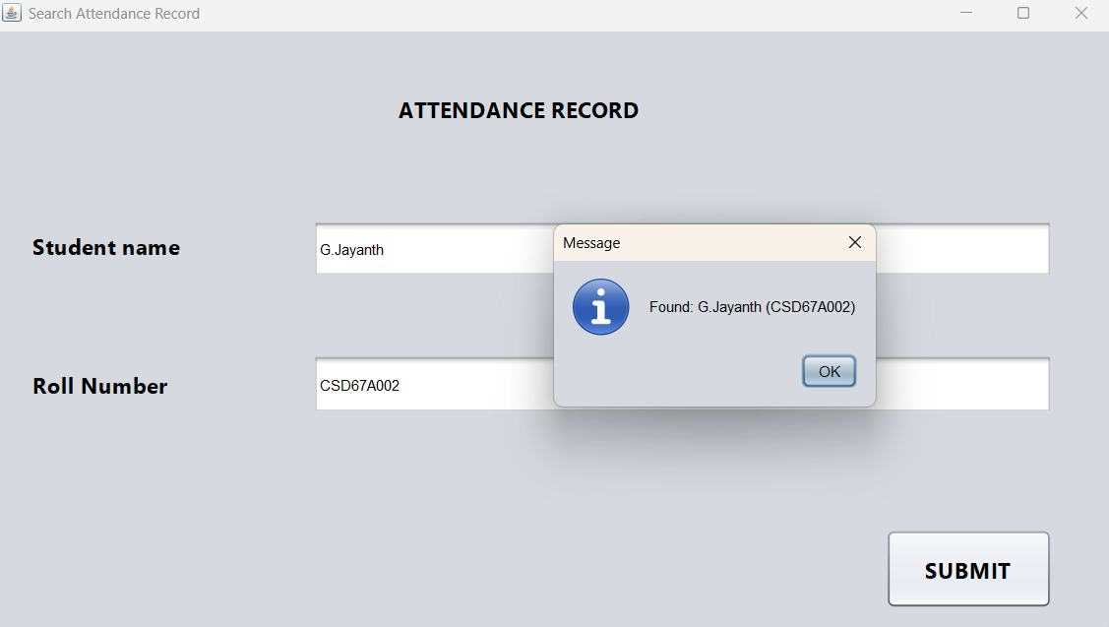
Search Attendance
Search students using Name or Roll Number.

Slide 9
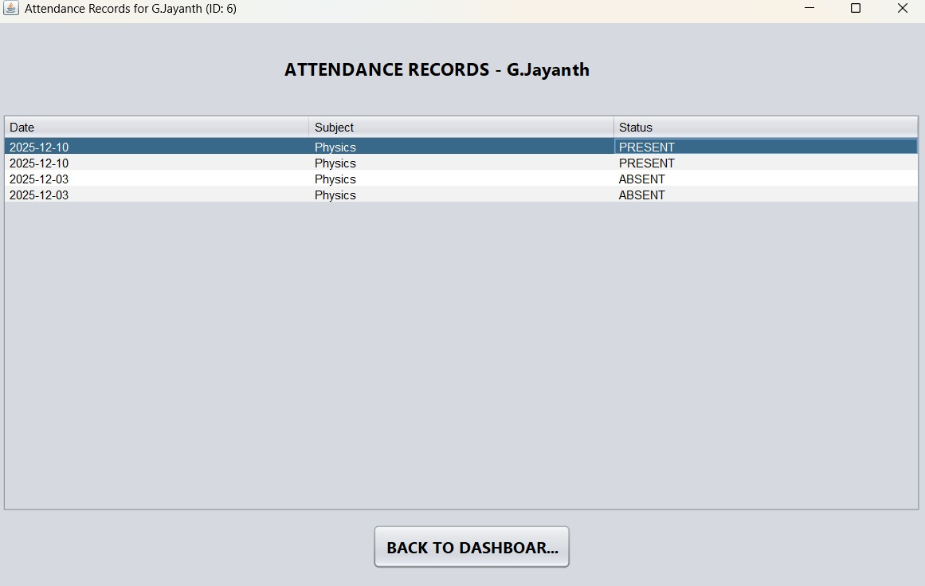
Student Attendance Records
Full attendance history of a selected student.

Slide 10
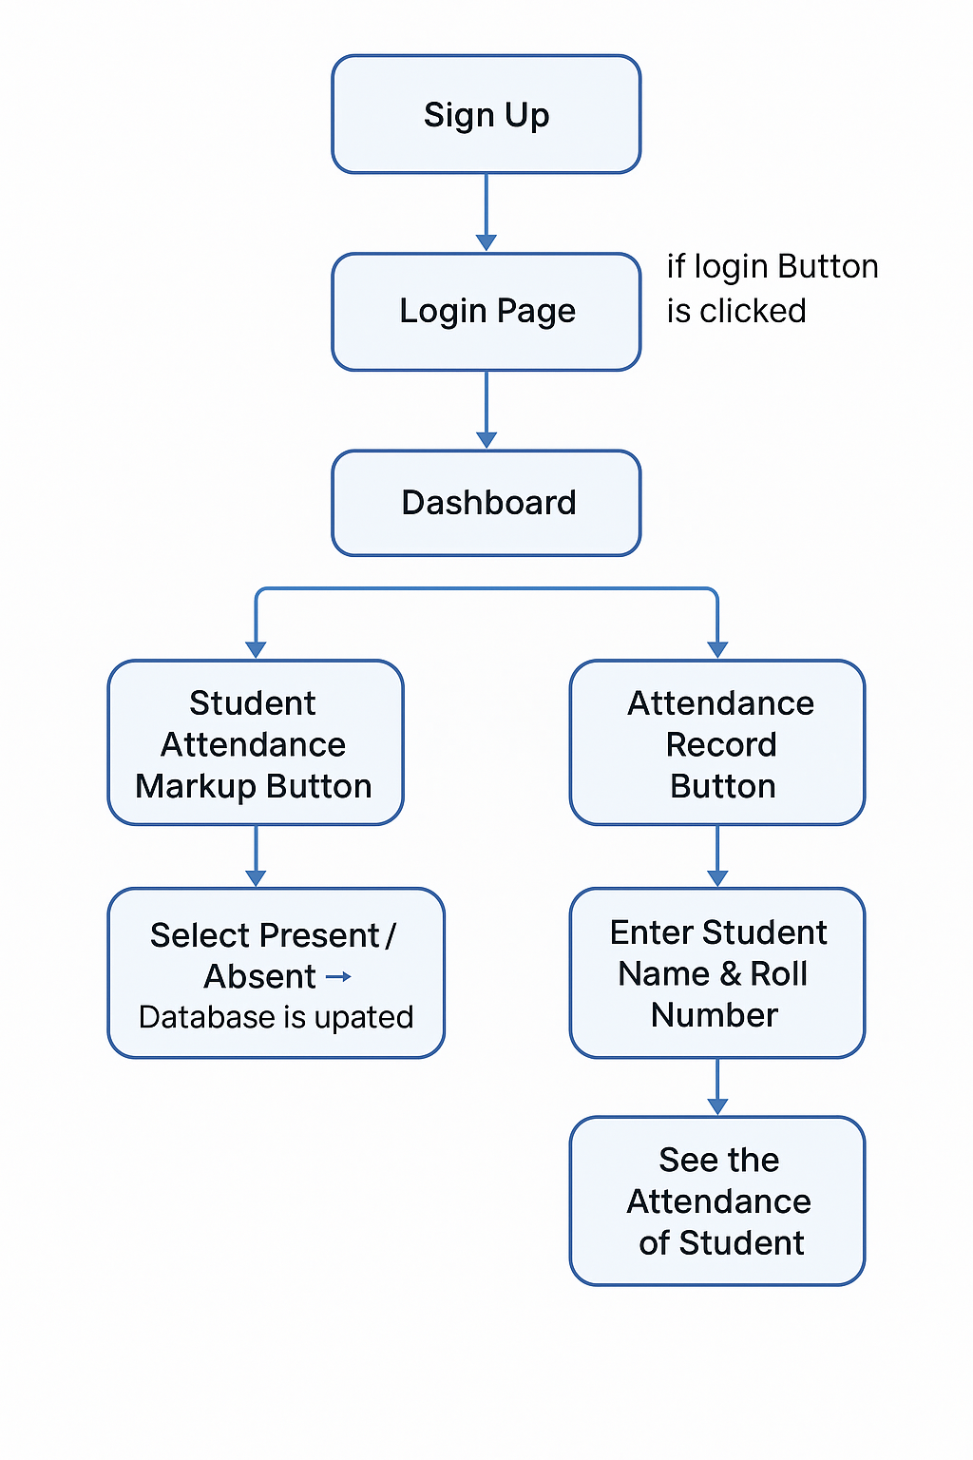
Flowchart
System workflow diagram.

Slide 11
Features
• Secure Login & Registration
• Attendance Marking
• Class Selection
• Search & View Attendance
• Java Swing UI
• MySQL Database Storage

Slide 12
Conclusion
The Attendance Tracker automates attendance, improving accuracy and speed.

Slide 13
Thank You

